Slide 1
JavaScript Ajax
Presented By
Kumar.R B.sc(cs).,B.lis(mang).,Mca.,M.Phil(image processing),
Chennai-Velachery
Fita & Infinix Pvt Limited

Slide 2
What is Ajax?
AJAX is an acronym for Asynchronous JavaScript and XML. It is a group of inter-related technologies like JavaScript, DOM, XML, HTML, CSS etc.
AJAX allows you to send and receive data asynchronously without reloading the web page. So it is fast.
Read data from a web server - after the page has loaded
Update a web page without reloading the page
Send data to a web server - in the background

Slide 3
Cond/
AJAX allows you to send only important information to the server not the entire page. So only valuable data from the client side is routed to the server side. It makes your application interactive and faster.

Slide 4
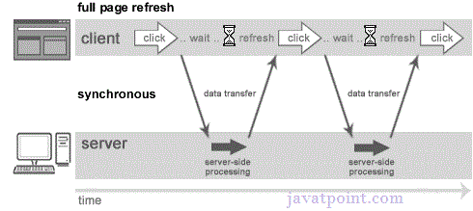
Understanding Synchronous vs Asynchronous Requests
Synchronous (Classic Web-Application Model)
A synchronous request blocks the client until operation completes i.e. browser is not unresponsive. In such case, javascript engine of the browser is blocked.

Slide 5
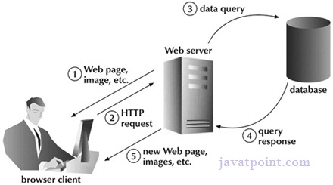
Let's understand it another way.

Slide 6
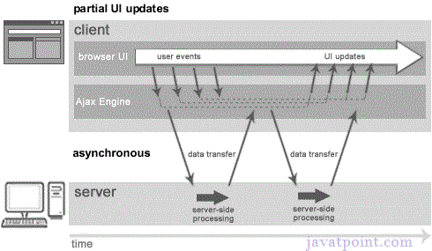
Asynchronous (AJAX Web-Application Model)
An asynchronous request doesn’t block the client i.e. browser is responsive. At that time, user can perform another operations also. In such case, JavaScript engine of the browser is not blocked.

Slide 7
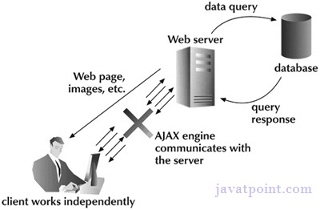
As you can see in the above image, full page is not refreshed at request time and user gets response from the ajax engine.

Slide 8
What is AJAX?
AJAX = Asynchronous JavaScript And XML.
AJAX is not a programming language.
AJAX just uses a combination of:
A browser built-in XMLHttpRequest object (to request data from a web server)
JavaScript and HTML DOM (to display or use the data)

Slide 9
AJAX is a misleading name. AJAX applications might use XML to transport data, but it is equally common to transport data as plain text or JSON text.
AJAX allows web pages to be updated asynchronously by exchanging data with a web server behind the scenes. This means that it is possible to update parts of a web page, without reloading the whole page.

Slide 10
Html Code
<!DOCTYPE html> <html> <body> <div id="demo"> <h2>Let AJAX change this text</h2> <button type="button" onclick="loadDoc()">Change Content</button> </div> </body> </html>

Slide 11
The HTML page contains a <div> section and a <button>.
The <div> section is used to display information from a server.
The <button> calls a function (if it is clicked).

Slide 12
Ajax Example
function loadDoc() { var xhttp = new XMLHttpRequest(); xhttp.onreadystatechange = function() { if (this.readyState == 4 && this.status == 200) { document.getElementById("demo").innerHTML = this.responseText; } }; xhttp.open("GET", "ajax_info.txt", true); xhttp.send(); }

Slide 13
AJAX Technologies
As describe earlier, ajax is not a technology but group of inter-related technologies. AJAX technologies includes:
HTML/XHTML and CSS
DOM
XML or JSON
XMLHttpRequest
JavaScript

Slide 14
HTML/XHTML and CSS
These technologies are used for displaying content and style. It is mainly used for presentation.
DOM
It is used for dynamic display and interaction with data.
XML or JSON
For carrying data to and from server. JSON (Javascript Object Notation) is like XML but short and faster than XML.

Slide 15
XMLHttpRequest
For asynchronous communication between client and server. For more visit next page.
JavaScript
It is used to bring above technologies together.
Independently, it is used mainly for client-side validation.

Slide 16
Understanding XMLHttpRequest
An object of XMLHttpRequest is used for asynchronous communication between client and server.
It performs following operations:
Sends data from the client in the background
Receives the data from the server
Updates the webpage without reloading it.

Slide 17
Properties of XMLHttpRequest object
Property | Description
onReadyStateChange | It is called whenever readystate attribute changes. It must not be used with synchronous requests.
readyState | represents the state of the request. It ranges from 0 to 4.0 UNOPENED open() is not called. 1 OPENED open is called but send() is not called. 2 HEADERS_RECEIVED send() is called, and headers and status are available. 3 LOADING Downloading data; responseText holds the data. 4 DONE The operation is completed fully.
reponseText | returns response as text.
responseXML | returns response as XML

Slide 18
Methods of XMLHttpRequest object
Method | Description
void open(method, URL) | opens the request specifying get or post method and url.
void open(method, URL, async) | same as above but specifies asynchronous or not.
void open(method, URL, async, username, password) | same as above but specifies username and password.
void send() | sends get request.
void send(string) | send post request.
setRequestHeader(header,value) | it adds request headers.

Slide 19
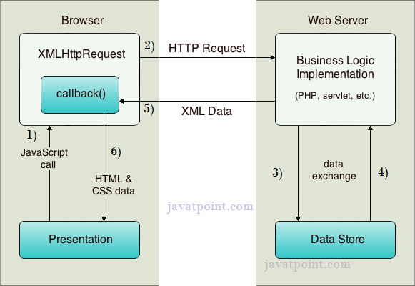
How AJAX works?
AJAX communicates with the server using XMLHttpRequest object. Let's try to understand the flow of ajax or how ajax works by the image displayed below.

Slide 20
XMLHttpRequest object plays a important role.
As you can see in the above example, User sends a request from the UI and a JavaScript call goes to XMLHttpRequest object.
HTTP Request is sent to the server by XMLHttpRequest object.
Server interacts with the database using JSP, PHP, Servlet, ASP.net etc.
Data is retrieved.
Server sends XML data or JSON data to the XMLHttpRequest callback function.
HTML and CSS data is displayed on the browser.

Slide 21
?

